Slide 1
INTRODUCTION TO MACHINE LEARNING
May 18, 2020

Slide 2


Who am I?
Data Science Platform for model-driven businesses
Josh Mineroff
Field Engineer | Domino
Notes:
Going to include learnings from many of our customers. Benefit of working with leading data science organizations

Slide 3
Teaching Assistants
Andrea Lowe
Field Engineer | Domino
Akshay Ambekar
Field Engineer | Domino

Slide 4

Agenda
TITLE | DURATION
ACCESS DOMINO | 10 MIN
MOTIVATION | 15 MIN
WORKSHOP & HANDS-ON | 50 MIN
Q&A | 15 MIN
Notes:
First section — going to spend time motivating the problem. important. This is actually a big deal, want to spend some time on why it’s such a big deal.
Then we’ll get more concrete.
And going to do some exercises.

Slide 5
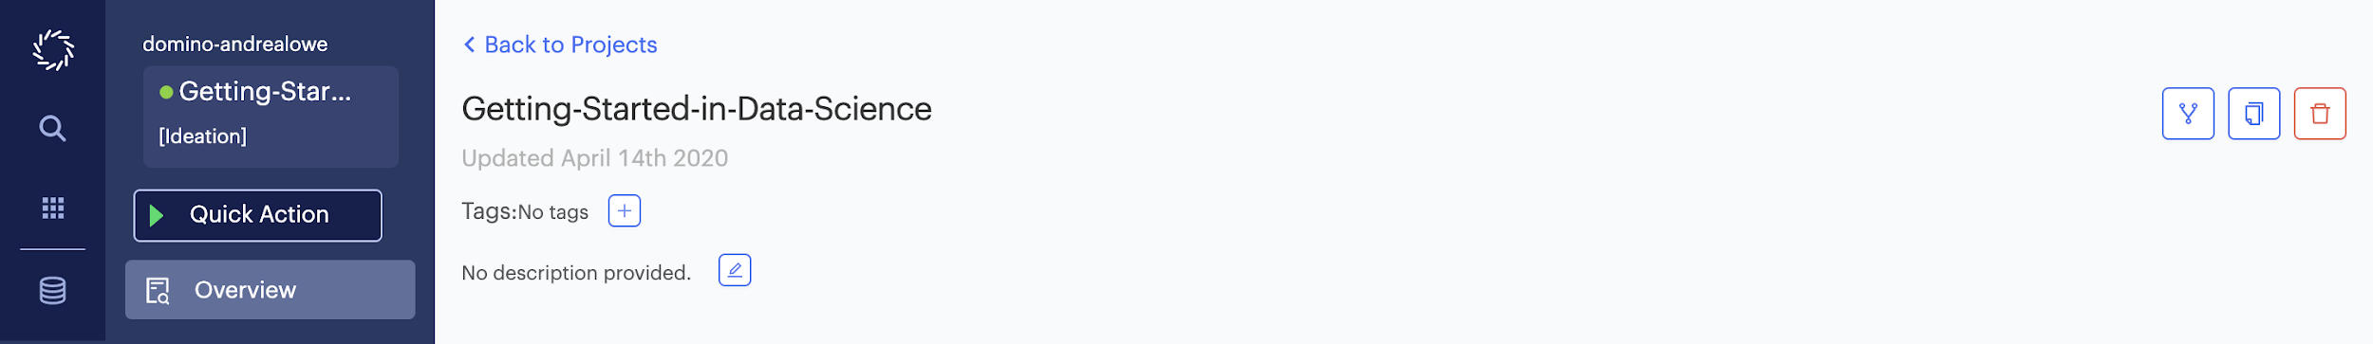
Access Materials
Log into workshop.cs.domino.tech
Navigate to https://workshop.cs.domino.tech/u/domino-jmineroff/Getting-Started-in-Data-Science/overview
Fork the project
Notes:
*review activity

Slide 6
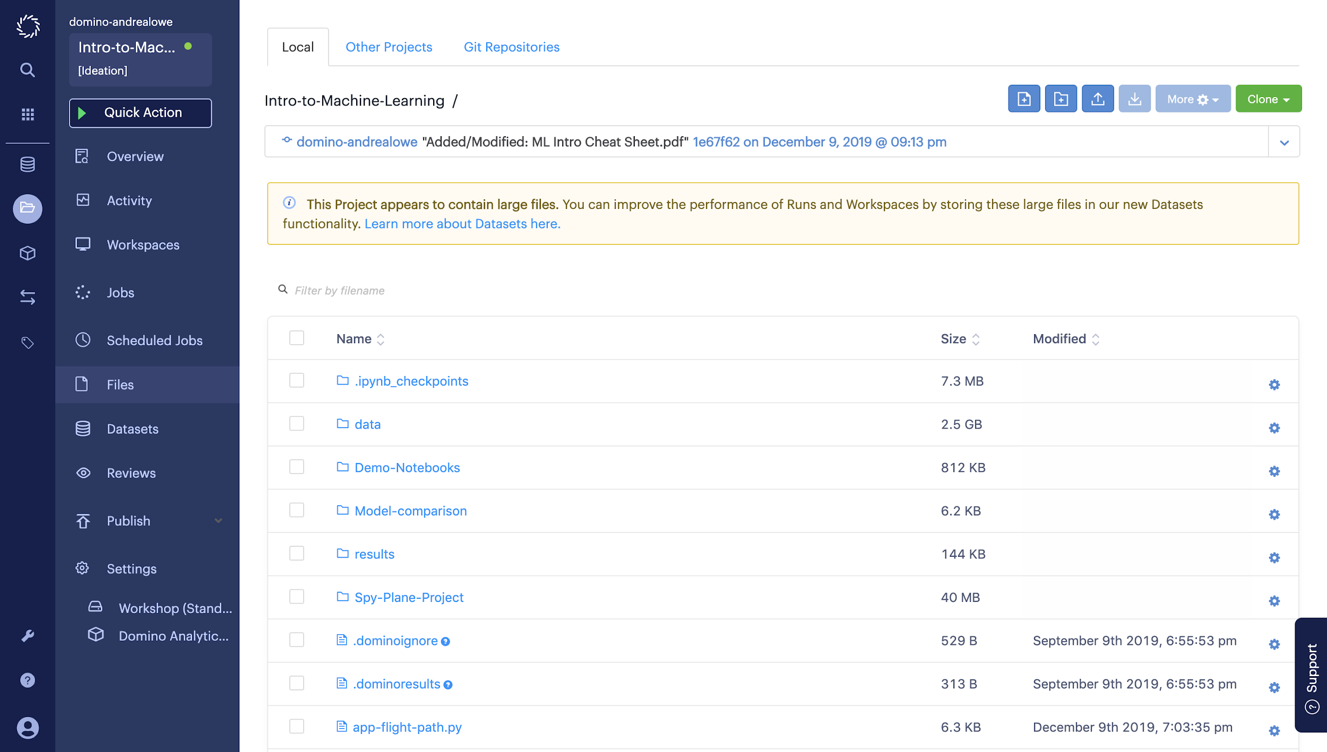
Access Files

Slide 7
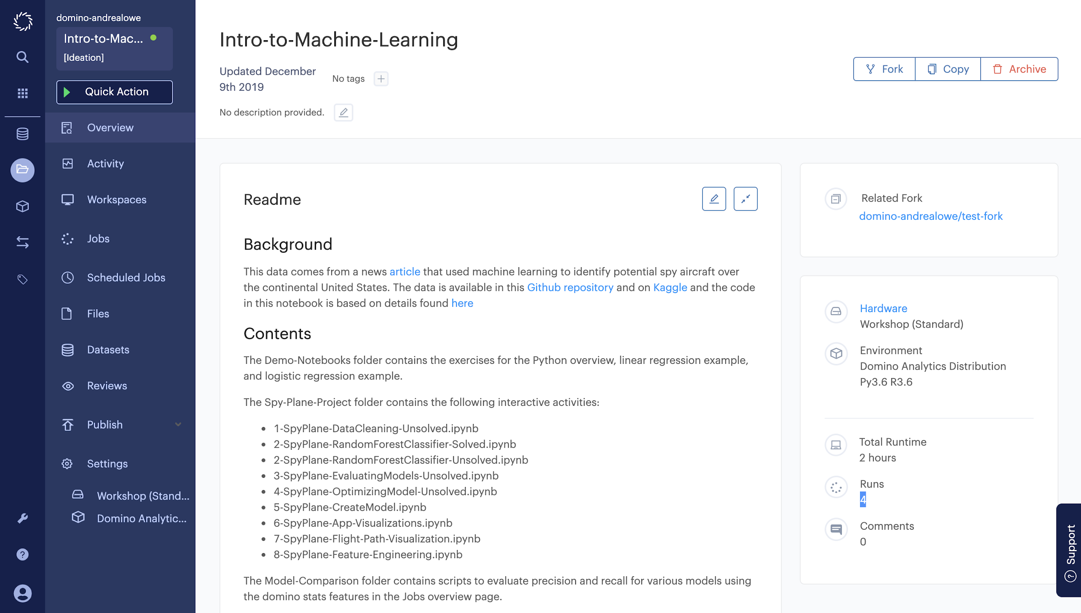
Need Help?
X

Slide 8
At the heart of data science lies an innocuous sounding thing…

Slide 9
called a model.

Slide 10
The most successful companies run their businesses on models
Notes:
Explain what a model is and why it’s different from “people looking at data”

Slide 11

9

Slide 12
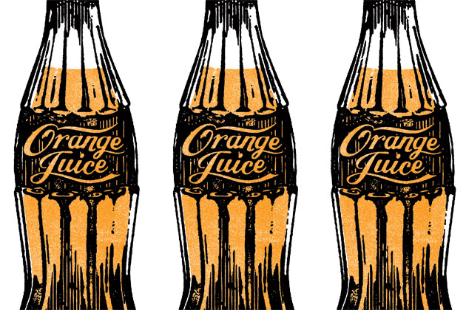
10

Slide 13
11

Slide 14
12
Companies that don’t run their business on models face an existential threat
The implications of not becoming a Model-Driven business are existential.
Notes:
Threat is the other companies that are leveraging DS across their org

Slide 15
1
2
Breakthroughs that open new revenue streams, expand into new markets, create new products.
Operational efficiencies that compound through constant incremental improvement.

Slide 16
Many organizations treat data science as a technical practice —
instead of an organizational capability
Notes:
Going to get more concrete and do some fun hands-on modeling in a bit, but if you walk away (or close out of the Zoom) remembering only one thing, it should be this

Slide 17
Jeff Bezos’s 2016 Annual Letter to Shareholders:
At Amazon, we’ve been engaged in the practical application of machine learning for many years now. Some of this work is highly visible: our autonomous Prime Air delivery drones; the Amazon Go convenience store that uses machine vision to eliminate checkout lines; and Alexa, our cloud-based AI assistant.
But much of what we do with machine learning happens beneath the surface. Machine learning drives our algorithms for demand forecasting, product search ranking, product and deals recommendations, merchandising placements, fraud detection, translations, and much more.

Slide 18






How Model-Driven Organizations Operate
Data science leaders
Risk and compliance leaders
Validation & Review
Model Development
Model Delivery/
Deployment
Business stakeholders and IT system owners
Data Scientists
Monitoring & Feedback
Business leaders &
Data science leaders
CIOs and IT leaders
Notes:
Tight orchestration across many stakeholders in iterative lifecycle
You have an awesome data science team, pitch to them the same way you might pitch to your Product team
Building empathy, not about finger pointing
Technology can help reduce the friction of this cycle

Slide 19
How Model-Driven Organizations Operate
Data science leaders
Risk and compliance leaders
Validation & Review
Model Development
Model Delivery/
Deployment
Business stakeholders and IT system owners
Data Scientists
Monitoring & Feedback
Business leaders &
Data science leaders
CIOs and IT leaders

Slide 20
Pick the right problem to solve
Notes:
I think I’ve talked enough about how important models can be, but you want to make sure you are building the right models

Slide 21
Project Prioritization
Calculate Value ($100k, $1M, $10M, etc.)
Estimate Effort (hour, day, week, year, etc.)
Forecast Risks
Barriers to adoption
Potential consequences of errors or performance degradation
“Product management” principles apply to data science projects just as much as engineering projects
High
VALUE
Low
EFFORT
Low
High
Risk
Notes:
Order of magnitude estimates
Value: how much improvement is realistic?

Slide 22
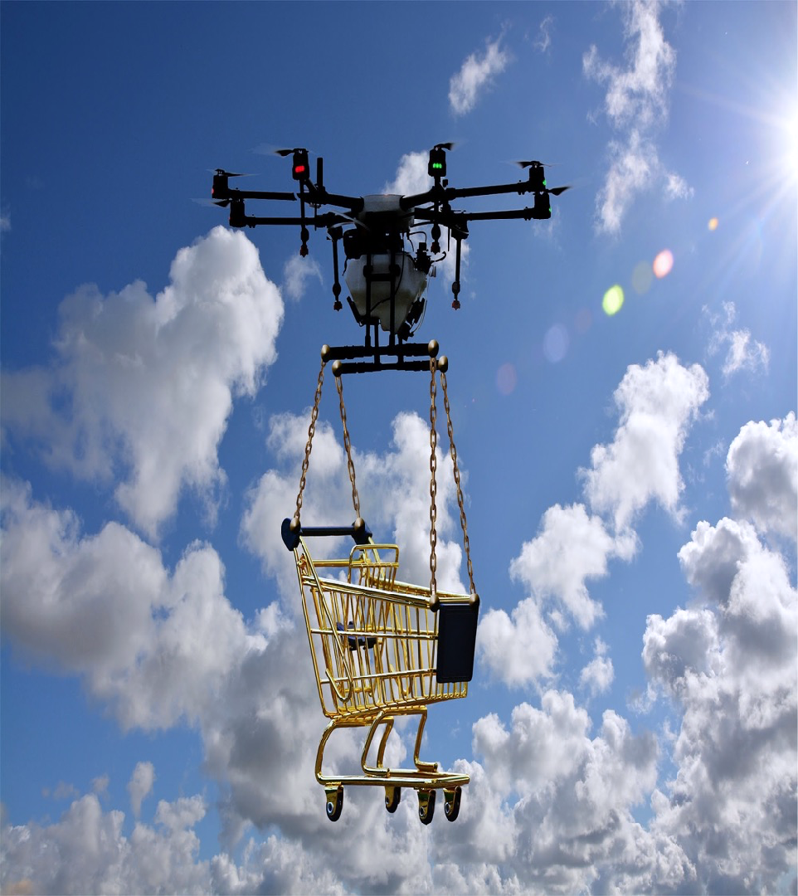


Other Considerations
Data Availability
Can use current data limitations to define future data engineering needs
Prior Art Review
Review state of the art — internally and externally
Model Delivery Plan
How will this model be deployed?
Proceed incrementally to get feedback from real usage
Success Measures
How will we know if this worked?
Frame in terms of business KPIs
Notes:
Can use current DS data limitations to define future data engineering needs

Slide 23
The Model Myth
The misconception that because models involve code and data, they should be treated the same as software or data

Slide 24
Traditional Programming
Data
Output
Program
Machine Learning
Data
Program
Output
https://www.seas.upenn.edu/~cis519/fall2017/lectures/01_introduction.pdf

Slide 25





Model Development
Evaluate Model
Share & Collaborate
Get Data
Build Model
Prepare Data

Slide 26
How Do I Get Data?
GET DATA
Read in files, images, text, etc.
Connect to database
Use an API
Web scraping
…

Slide 27
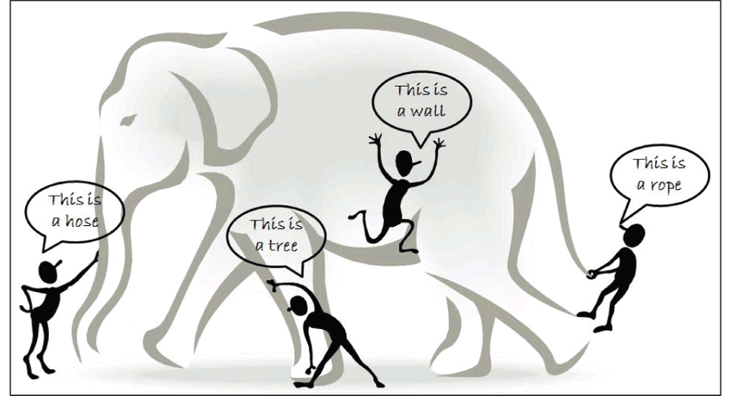
Get LOTS OF Data!
GET DATA
https://www.researchgate.net/publication/301325506_Analysis_of_Data_Mining_Techniques_and_its_Applications
Notes:
It’s really important to make sure you have data that covers the features needed to classify or predict whatever it is that you’re hoping to find. For example, if we were hoping to classify images of elephants but only had pictures of the tail, we wouldn’t be able to do this effectively and would need to pull in images that cover the entirety of the elephant. Many times, this requires pulling in data from more than one source and figuring out how to connect these together.

Slide 28
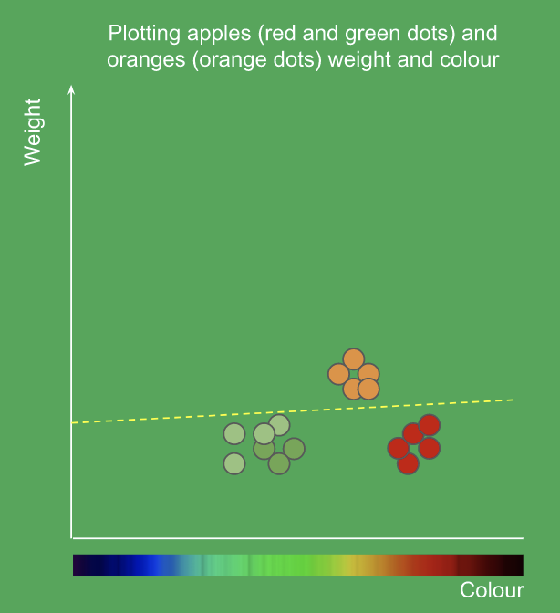
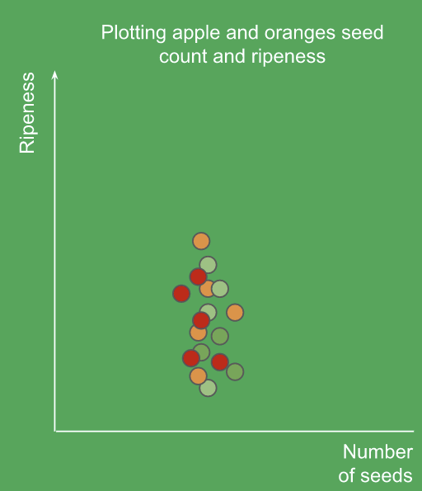
Get USEFUL Data!
GET DATA
https://goo.gl/5Wd2vy
Notes:
It’s really important to make sure you have data that covers the features needed to classify or predict whatever it is that you’re hoping to find. For example, if we were hoping to classify images of elephants but only had pictures of the tail, we wouldn’t be able to do this effectively and would need to pull in images that cover the entirety of the elephant. Many times, this requires pulling in data from more than one source and figuring out how to connect these together.

Slide 29
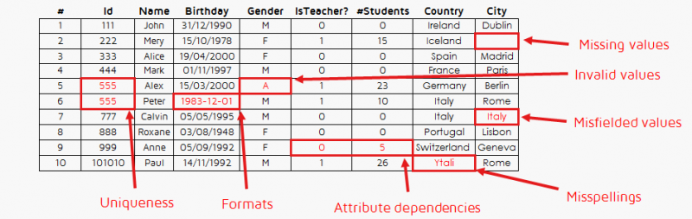
Inspect the Data
GET DATA
Visualize data
Look at descriptive statistics
Look for misfielded values
Notes:
It’s really important to make sure you have data that covers the features needed to classify or predict whatever it is that you’re hoping to find. For example, if we were hoping to classify images of elephants but only had pictures of the tail, we wouldn’t be able to do this effectively and would need to pull in images that cover the entirety of the elephant. Many times, this requires pulling in data from more than one source and figuring out how to connect these together.

Slide 30
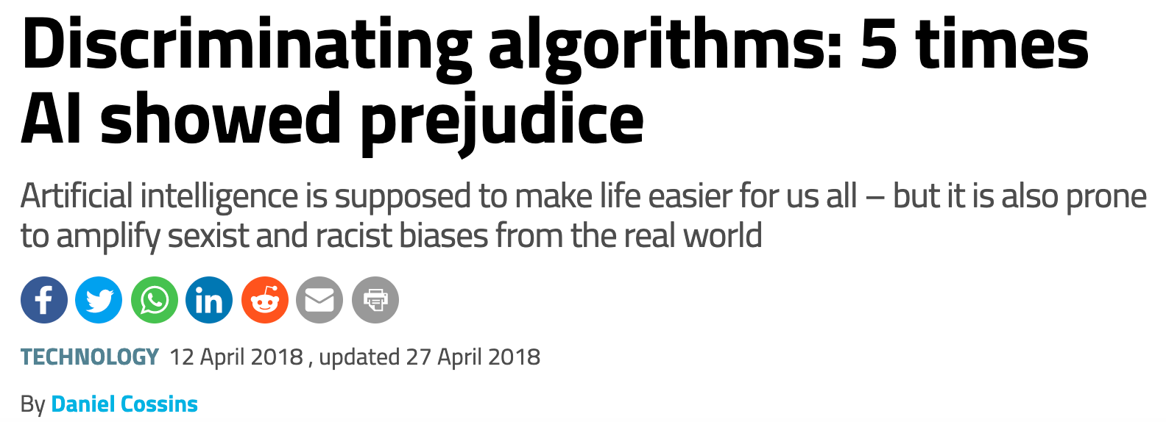
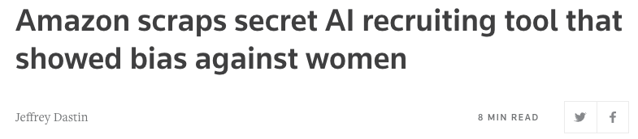
Data Bias
GET DATA
https://www.newscientist.com/article/2166207-discriminating-algorithms-5-times-ai-showed-prejudice/
Notes:
It’s also really important to make sure you understand your data and that you’ve cleaned this properly. For example, you may be looking at airport delays with one of your columns being timestamps from the flights - it would be important to extract the hour of the day for training instead of the entire date time. Another very important thing to keep in mind is that if you feed in biased or skewed data then your algorithm is going to be biased. There are many news articles about, with one famous case being the algorithm widely used in the US to guide sentencing by predicting the likelihood of a criminal reoffending. According to the analysis, the system predicts that black defendants pose a higher risk of recidivism than they do, and the reverse for white defendants. There are also many other things to consider about how our data looks that we’ll cover later.

Slide 31
Efficient Cell Network Provisioning
Cell towers are typically overprovisioned to smoothly support peak hour loads
Next-gen networks can adjust this dynamically
How can we anticipate traffic variations to get more value out of limited network resources?
https://www.kaggle.com/c/anomaly-detection-in-cellular-networks/data

Slide 32
HANDS-ON: DATA EXPLORATION

Slide 33
Model Development
Evaluate Model
Share & Collaborate
Get Data
Build Model
Prepare Data

Slide 34
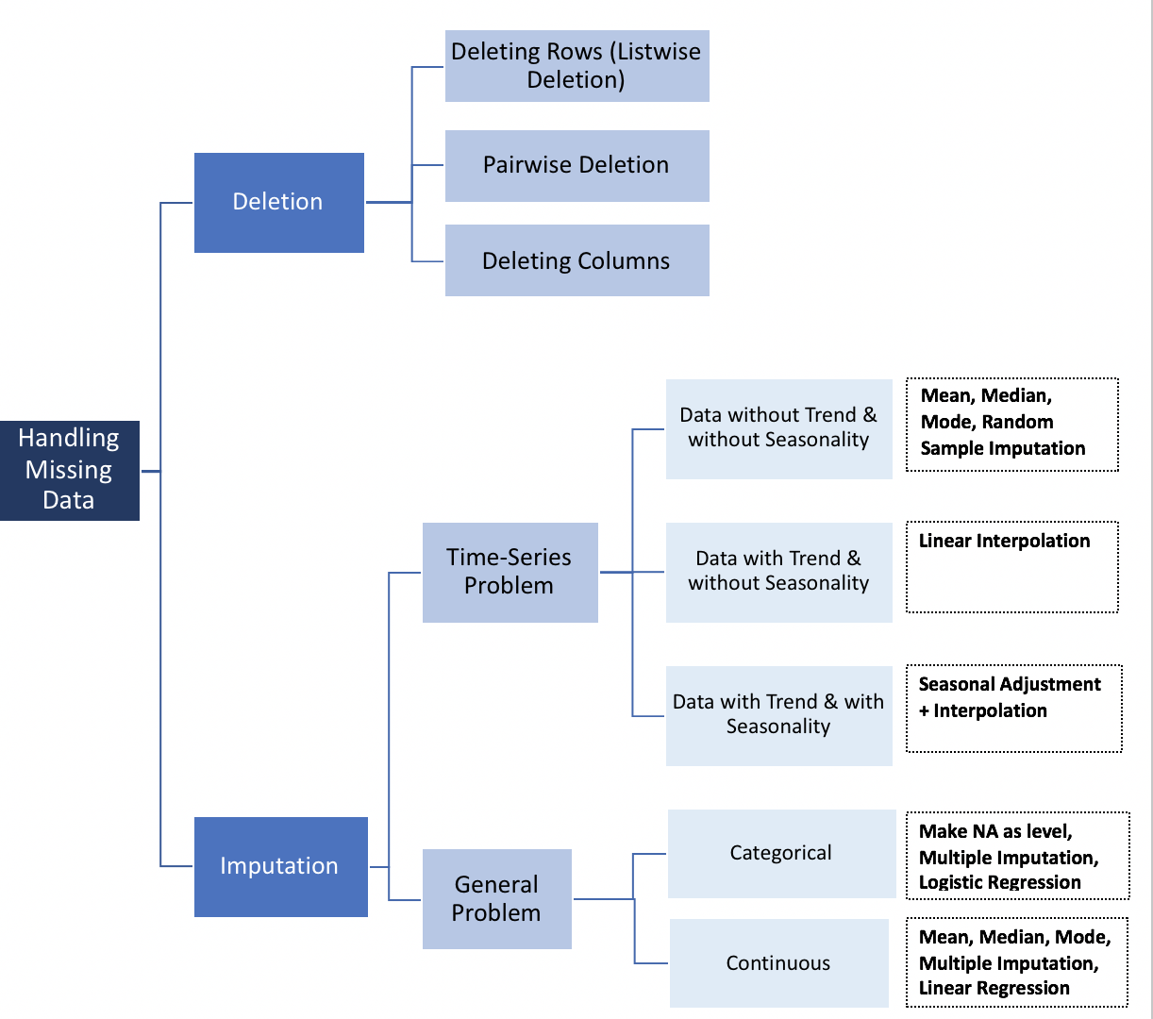
Missing Values
PREPARE
DATA
Are these missing at random?
Example: those with higher salaries may not report income on survey
Will removing these introduce bias?
https://towardsdatascience.com/how-to-handle-missing-data-8646b18db0d4
Notes:
Maybe the missing values are correlated with another attribute (people with high salaries don’t want to reveal their income on surveys)

Slide 35
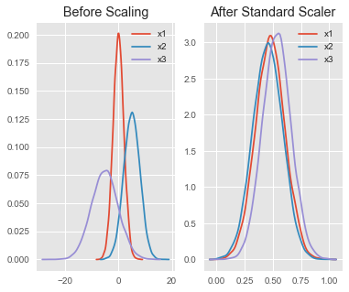
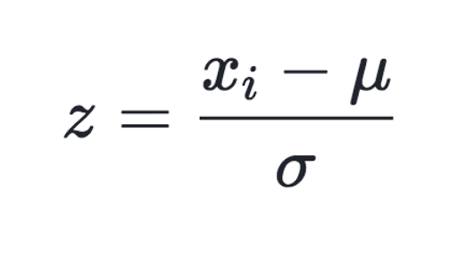
Scaling
PREPARE
DATA
Compare features with different units or scales
Rescales data to have a mean of 0 and a standard deviation of 1
Changing range of data
https://becominghuman.ai/demystifying-feature-scaling-baff53e9b3fd
Notes:
The difference is that, in scaling, you’re changing the range of your data (while in normalization you’re changing the shape of the distribution of your data). This assumes your data is normally distributed within each feature

Slide 36
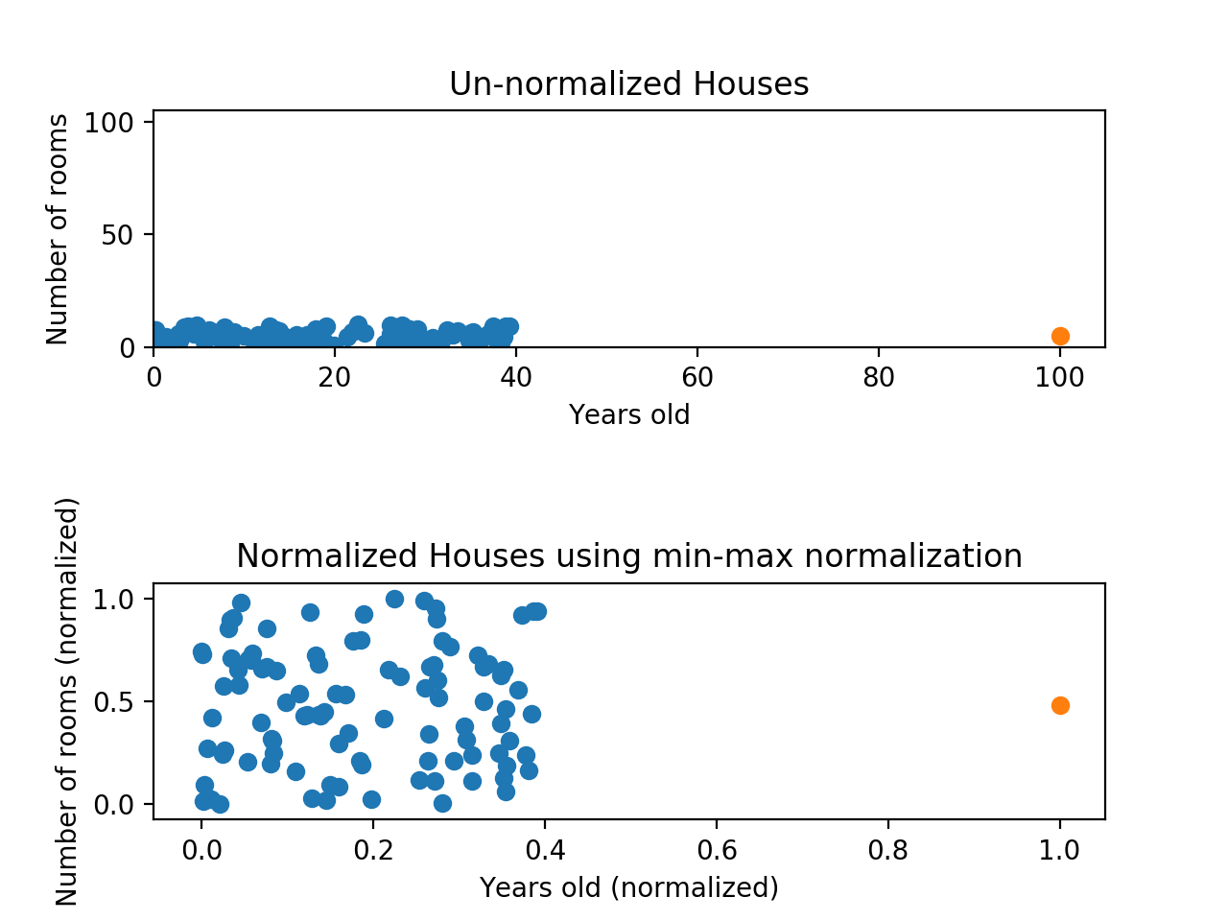
Scaling
PREPARE
DATA
Scaling fixed the “compression” on y-axis but x-axis is still problematic
Y-axis would dominate when comparing
Notes:
Min-max normalization has one fairly significant downside: it does not handle outliers very well. For example, if you have 99 values between 0 and 40, and one value is 100, then the 99 values will all be transformed to a value between 0 and 0.4. That data is just as squished as before! Take a look at the image below to see an example of this.
Normalizing fixed the squishing problem on the y-axis, but the x-axis is still problematic. Now if we were to compare these points, the y-axis would dominate; the y-axis can differ by 1, but the x-axis can only differ by 0.4.

Slide 37
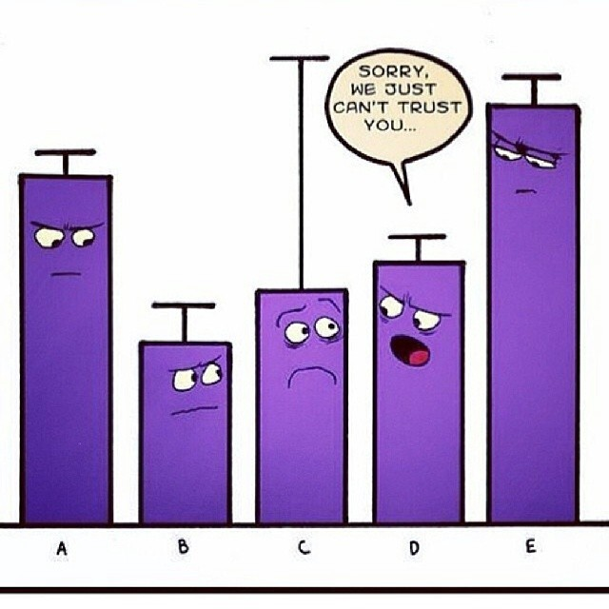
Outliers
PREPARE
DATA
Identify statistically
Consider the cause - sampling, experimental, or data entry errors?
Methods to correct for outliers:
Delete
Impute - replace with mean, median, or most frequent
Transform or bin data
https://medium.com/datadriveninvestor/unboxing-outliers-in-machine-learning-d43fe40d88a6

Slide 38
Feature Engineering
PREPARE
DATA
Using domain knowledge to create features that make algorithms work
Can use bucketing (i.e. for age), combining (i.e. for latitude and longitude), extracting (i.e. hour of day)
Remove features that are just creating noise or are not improving models but increasing run time
Notes:
Uses domain knowledge - say you have time stamps for predicting flight delays, you might want to consider just the hour of the day initially
Bucketing (age), combining (latitude and longitude)
Extra features can decrease performance because they may “confuse” the model by giving it irrelevant data that prevents it from learning the actual relationships.
The random forest performs implicit feature selection because it splits nodes on the most important variables, but other machine learning models do not.

Slide 39

Summary
PREPARE
DATA
Outliers
Missing values
Scaling
Feature Engineering
Main Takeaway
Data cleaning is the key step to making machine learning algorithms work

Slide 40
HANDS-ON: DATA EXPLORATION & PREPARATION

Slide 41
Model Development
Evaluate Model
Share & Collaborate
Get Data
Build Model
Prepare Data

Slide 42
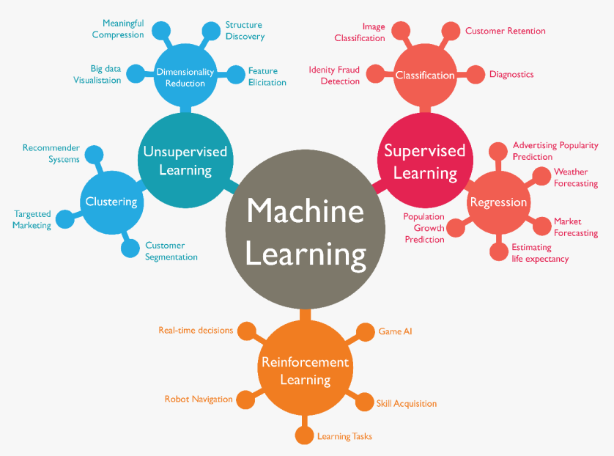
Types of Models
BUILD
MODEL
Supervised vs. Unsupervised
Classification vs. Regression
https://medium.com/forsk-labs/machine-learning-for-beginners-71c391f327ed
Notes:
This chart shows the main branches of machine learning, which are supervised and unsupervised learning, along with reinforcement learning. It also gives of further separation of both supervised learning and unsupervised learning and some examples what can fall under these categories such as compression for dimensionality reduction, diagnostics for classification, or weather forecasting for regression.

Slide 43
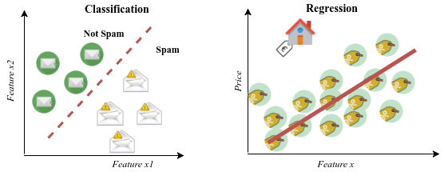
Supervised Learning
BUILD
MODEL
Uses Labeled Data to predict future outcomes based on past performance
https://www.researchgate.net/publication/319093376_DEEP_GENERATIVE_MODELS_FOR_SYNTHETIC_RETINAL_IMAGE_GENERATION
Notes:
Key is if you’re looking at your data set and one column is the answer

Slide 44
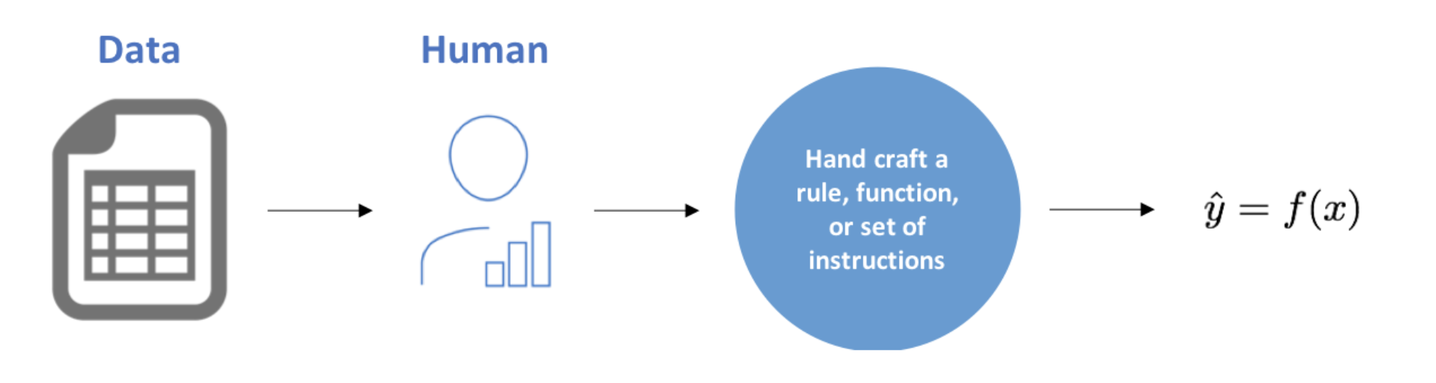
Human Modeling
BUILD
MODEL

Slide 45
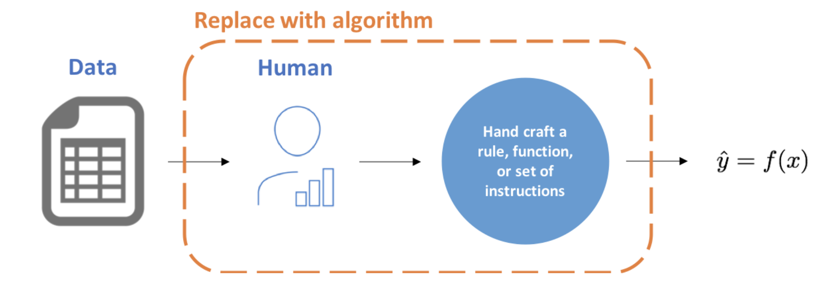
Machine Learning
BUILD
MODEL

Slide 46

Choosing an Algorithm
BUILD
MODEL
https://scikit-learn.org/stable/tutorial/machine_learning_map/index.html
Notes:
Now that we’ve talked about data we can talk about choosing a model. You’ve likely heard about models such as regression or maybe even xgboost or deep learning. And you’re likely wondering how to go about choosing a model. You’ll find charts such as this one from scikit learn, a very widely used Python package for machine learning. In general, you’ll be able to narrow down your selection based on whether you have labeled data and are predicting a category vs a quantity. However, this chart does not even begin to cover all of the models available or go into things like neural networks or reinforcement learning.
The main takeaway from this is that there is usually never one best algorithm, in fact in many cases you might test out a few different models to see which performs best.

Slide 47

Decision Trees
BUILD
MODEL
Model a set of sequential, hierarchical decisions that ultimately lead to some final classification
Data automatically divided to yes/no questions
The higher the branch, the broader the question
https://blog.statsbot.co/machine-learning-algorithms-183cc73197c
Notes:
-another slide on all the classification algorithms

Slide 48
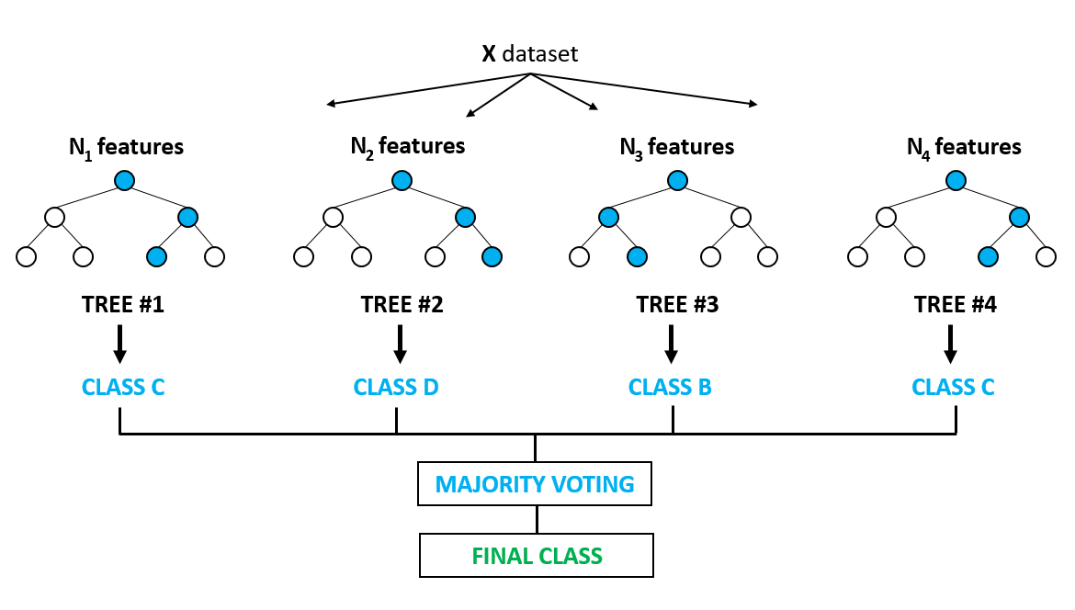
Random Forest Classifier
BUILD
MODEL
Less likely to overfit
Few statistical assumptions
Data does not need to be normally distributed
Relationships don’t need to be linear
https://medium.com/@ar.ingenious/applying-random-forest-classification-machine-learning-algorithm-from-scratch-with-real-24ff198a1c57
Notes:
Random Forest classifiers are a type of algorithm based on bagging, or bootstrap aggregating.They average multiple deep decision trees, trained on different parts of the same training set, with the goal of reducing the variance. Each decision tree in the forest considers a random subset of features when forming questions and only has access to a random set of the training data points. The random forest takes an average of all the individual decision tree estimates or the majority vote of the decision tree class.

Slide 49
HANDS-ON: BUILDING A MODEL

Slide 50
Model Development
Evaluate Model
Share & Collaborate
Get Data
Build Model
Prepare Data

Slide 51
Using Data to Test Model
EVALUATE
MODEL
Need a model that performs well on data it hasn’t seen before
Can split labeled data into test and train sets
Prevents overfitting

Slide 52
Real World Data
EVALUATE
MODEL
Increasing RMSE may not matter in the user experience
Business metrics and stakeholder impact are vital
What is the cost/impact of a false positive or false negative or incorrect prediction?

Slide 53


Accuracy
EVALUATE
MODEL
Out of 100 patients, 99 will be disease free
My model has an accuracy of 99% - this is good right??
This means that the model predicts every patients as disease free, therefore not useful at all

Slide 54
Confusion Matrix
EVALUATE
MODEL
 |  | Actual Values
 |  | Positive | Negative
Predicted Values | Positive | True Positives | False Positives
 | Negative | False Negatives | True Negatives
Notes:
A confusion matrix is a summary of prediction results on a classification problem. Here we can see the counts of how many correct and incorrect predictions were made for both the positive and negative classes (in our case the positive would be a surveillance or spy plane and negative would be the other, or normal, class).
The name stems from the fact that it makes it easy to see if the system is confusing two classes (i.e. commonly mislabeling one as another).
*explain how to remember the true pos and neg, fals pos and neg

Slide 55
Confusion Matrix: Email Spam
EVALUATE
MODEL
 |  | Actual Values
 |  | Spam | Regular Email
Predicted Values | Spam | Moved spam (True Positive) | Moved regular email (False Positive)
 | Regular Email | Left spam (False Negative) | Left regular email (True Negative)

Slide 56
Precision
EVALUATE
MODEL
Correctly identify only the relevant (positive) samples
Precision =
True Positives
True Positives + False Positives
 |  | Actual Values
 |  | Positive | Negative
Predicted Values | Positive | True Positives | False Positives
 | Negative | False Negatives | True Negatives

Slide 57
Precision
EVALUATE
MODEL
Perfect precision score of 1.0 means that every predicted spam was actually spam
Says nothing about whether all spam were identified

Slide 58
Recall
EVALUATE
MODEL
Correctly identify all of the relevant (positive) samples
True Positives
True Positives + False Negatives
Recall =
 |  | Actual Values
 |  | Positive | Negative
Predicted Values | Positive | True Positives | False Positives
 | Negative | False Negatives | True Negatives

Slide 59
Recall
EVALUATE
MODEL
Perfect recall score of 1.0 means that all spam emails were identified
Says nothing about how many regular emails were labeled as spam

Slide 60
F1 Score
EVALUATE
MODEL
Can be used to find optimal blend of precision and recall
Harmonic mean of the two
Used instead of average because it punishes extreme values
Useful when there is uneven class distribution
Perfect score = 1, total failure = 0
precision ⨉ recall
precision + recall
F1 Score = 2 ⨉
Notes:
Sometimes it’s more important to correctly classify your samples than getting all of them (high precision). Sometimes it’s more important to get all of them (high recall) than getting all of them correct. However, in cases where we want to find an optimal blend of precision and recall we can combine the two metrics using what is called the F1 score.
F1 Score might be a better measure to use if we need to seek a balance between Precision and Recall AND there is an uneven class distribution (large number of Actual Negatives).
Can measure this if only getting one thing and then explore

Slide 61
HANDS-ON: EVALUATING YOUR MODEL

Slide 62
Model Development
Evaluate Model
Share & Collaborate
Get Data
Build Model
Prepare Data

Slide 63

Wrapping-up a Project
Best Practices
Store positive and negative results
Preserve synthesis, intermediate results, code, data, and environment
Common Pitfalls
Repeated quiet failures
Old analysis doesn’t run
Notes:
PhD dissertation story
Large bank – Only 5-10% of projects initiated make it to the model inventory and they are the only ones that have key work preserved (even then it doesn’t run, just synthesis)

Slide 64
THANK YOU!

Slide 65
Pre-Launch Project Checklist: Questions to Ask
Business Case | What’s the desired outcome of the project, in terms of a business metric? What are the linkages from your project to impacting that ultimate business metric? What is the order-of-magnitude ROI and cost?
Stakeholders | Lead DS, Proposed Validator, Data Engineers, Product Manager, Business Executive, Business End User (internal or external), Application Developer, DevOps Engineer, Compliance
Technology | What compute hardware and software infrastructure do you anticipate being necessary? Would your project benefit from specialized or parallelized computing?
Data | What relevant data exists today? Who are the subject matter experts? What other data would we potentially want to capture, create, or buy externally?
Prior Art | Who has worked on this business topic before (internal and external)? Who are the relevant experts in the techniques I will likely use?
Model Delivery | Who will consume this and what form factor will the final product take (report, app, API)? What dependencies or resources will you require to deliver work this way (e.g., IT)? What are other possible delivery mechanisms, especially ones that are lighter weight or easier to test first? What user training is necessary to ensure adoption?
Success Measure | How will you know if it’s working as expected, or otherwise get feedback? What’s your “monitoring” plan, even if it’s manual and subjective?
Risk Mitigation | How could this model be mis-used by end users? Any constraints on modeling approach (e.g., interpretability requirements)?

Slide 66
Following slides are there in case they need to be added during rehearsal: will probably all be deleted

Slide 67
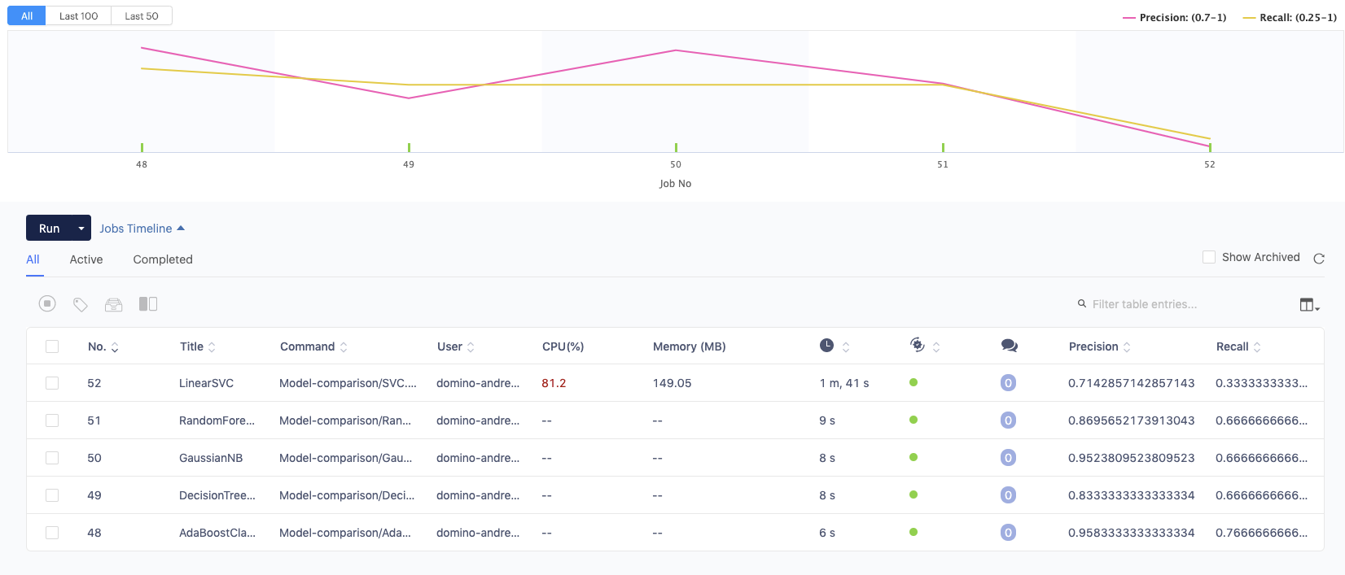
Activity - Diagnostic Statistics in Domino
Dominostats support docs
Notes:
*It’s likely that these algorithms are not a good fit for our data here. We would need to understand the underlying assumptions and the interpretability. However, there may be times where there are various models that could work for your problem and you want to get a quick idea of how some given

Slide 68
Improving Models
Can I get more relevant data?
Can I create more useful features out of my data or eliminate irrelevant ones?
Can I improve my model?
Notes:
Generally a simple model with more data will beat a complex model with limited data.

Slide 69
Hyperparameters
Settings that “tune” the algorithm for optimum performance
Unlikely to know ahead of time - trial-and-error
Different for each model
Random forest includes things like the number of decision trees in the forest or number of features when splitting a node
Balance compute time and scoring metric
Notes:
Hyperparameters can be thought of as the settings of an algorithm that can be adjusted to optimize performance. These are something you will set before training the model. You are unlikely to know what the best settings for these will be ahead of time, and tuning a model is where machine learning turns from a science into trial-and-error based engineering.
In the case of a random forest, hyperparameters include the number of decision trees in the forest and the number of features considered by each tree when splitting a node. Scikit-Learn implements default hyperparameters for all models, but these are not guaranteed to be optimal for a problem.
Remember this because the features are the parameters, and need a word for the things ….

Slide 70
Grid Search
Builds a model for every combination of the specified hyperparameters and evaluates model
Can change scoring method to maximize given metric or minimize some error
Randomized search more efficient, uses random combination of hyperparameters
Notes:
Can use randomized search and then narrow down with grid search

Slide 71
Overfitting and Underfitting
Underfitting - when model is unable to capture the underlying pattern of data (usually high bias and low variance)
Overfitting - model captures noise along with patterns (usually low bias and high variance)
Complex models are prone to overfitting
Notes:
underfitting happens when a model unable to capture the underlying pattern of the data. These models usually have high bias and low variance.
overfitting happens when our model captures the noise along with the underlying pattern in data. It happens when we train our model a lot over noisy dataset. These models have low bias and high variance. These models are very complex like Decision trees which are prone to overfitting.

Slide 72
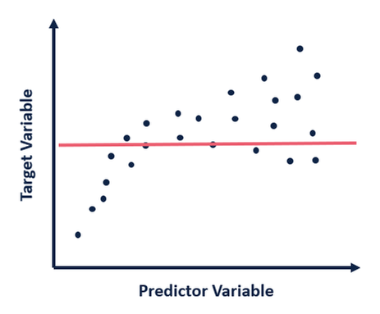
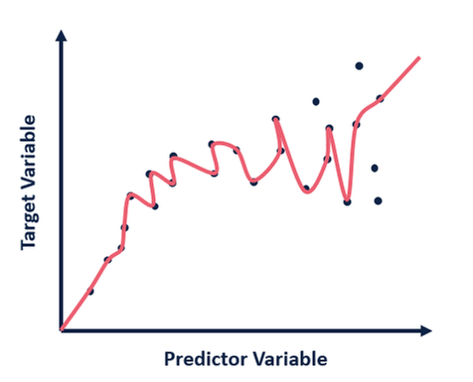
Overfitting and Underfitting
Underfitting
Overfitting
Notes:
How can we prevent Overfitting

Slide 73
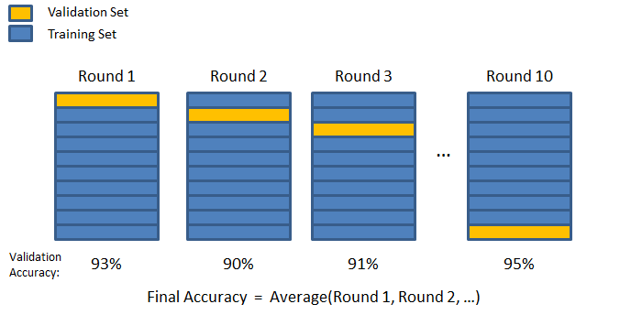
Cross Validation
Used to help eliminate over- and -underfitting
Re-sampling procedure to evaluate a model
Each data point gets used once in the training and testing set
Used by Grid Search
https://towardsdatascience.com/cross-validation-70289113a072
Notes:
Cross Validation is a very useful tool of a data scientist for assessing the effectiveness of the model, especially for tackling overfitting and underfitting. In addition,it is useful to determine the hyper parameters of the model, in the sense that which parameters will result in lowest test error.

Slide 74
Feature Engineering
Remove features that are just creating noise or are not improving models but increasing run time
Random forest classifiers perform some implicit feature selection because they split nodes on important variables
Can have models output the importance of different features
Notes:
In addition to creating useful features based on domain knowledge, we may also want to remove features.
Extra features can decrease performance because they may “confuse” the model by giving it irrelevant data that prevents it from learning the actual relationships.
The random forest performs implicit feature selection because it splits nodes on the most important variables, but other machine learning models do not.

Slide 75
Improving Models Summary
Try to find more relevant data
Use grid search to find optimal hyperparameters
Make sure to use test and train sets to prevent overfitting
Look at keeping only relevant features

Slide 76
Sharing Models

Slide 77

Create Interactive Data Products
Interactive dashboards
Model driven applications
Visualizations to explain model results
Tailor design to your audience: customer, business user, or executive

Slide 78



Common Web Application Frameworks for Data Scientists
Shiny
Easy to get started
Easy to debug
Focused on data
Exclusive to R
Dash
Python’s answer to Shiny
Harder than R, easier than Flask
Focused on data
Flask
General web app framework for Python

Slide 79
Dash
Python framework for building analytical web applications
Easy to publish in Domino
Ties together Plot.ly, React, and Flask

Slide 80
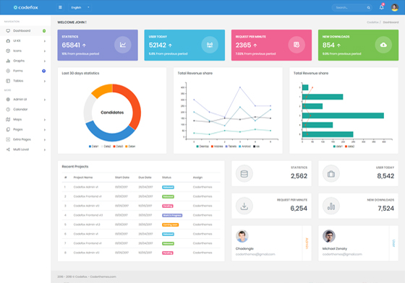


Web Apps in Domino
App Files
Start an app server
/mnt/…
app.sh

Slide 81
app.sh
Requirements for app.sh
Consists of commands to start your application server
Server must run at 0.0.0.0 on port 8888
Application Type | app.sh code examples
Shiny (R) | R -e 'shiny::runApp(appDir = "<path to app dir>", port = 8888, host = "0.0.0.0")'
Flexdashboard (R) | R -e 'rmarkdown::run("<path to Rmd>", shiny_args = list(port = 8888, host="0.0.0.0"))'
Dash (Python) | python app.py
Flask (Python) | export FLASK_APP=app.py export FLASK_DEBUG=1 export LANG="en_US.utf8" python -m flask run --host=0.0.0.0 --port=8888

Slide 82
Build an App
Draft layout
Create visualizations
Prepare data and/or model

Slide 83
Visualization packages
Matplotlib - low level, can customize easily
Pandas visualization - easy to use, built on matplotlib
Seaborn - high level, better default styles
Plotly - easy to use interactive graphs
Bokeh - interactive, targets web browsers for presentation

